Slide 1
Chapter 7: Entity-Relationship Model

Slide 2

Total and Partial Participation
Total participation (indicated by double line): every entity in the entity set participates in at least one relationship in the relationship set
  participation of student in advisor relation is total
    every student must have an associated instructor
Partial participation: some entities may not participate in any relationship in the relationship set
  Example: participation of instructor in advisor is partial

Slide 3

Notation for Expressing More Complex Constraints
A line may have an associated minimum and maximum cardinality, shown in the form l..h, where l is the minimum and h the maximum cardinality
  A minimum value of 1 indicates total participation.
  A maximum value of 1 indicates that the entity participates in at most one relationship
  A maximum value of * indicates no limit.
Instructor can advise 0 or more students. A student must have 1 advisor; cannot have multiple advisors

Slide 4
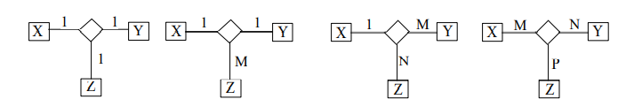
Cardinality Constraints on Ternary Relationship
A ternary relationship is a relationship of degree three. That is, a relationship that contains three participating entities.
Cardinalities for ternary relationships can take the form of 1:1:1, 1:1:M, 1:M:N or M:N:P.
The cardinality constraint of an entity in a ternary relationship is defined by a pair of two entity instances associated with the other single entity instance.
For example, in a ternary relationship R(X, Y, Z) of cardinality M:N:1, for each pair of (X, Y) there is only one instance of Z; for each pair of (X, Z) there are N instances of Y; for each pair of (Y, Z) there are M instances of X.

Slide 5
Primary Key
Primary keys provide a way to specify how entities and relationships are distinguished. We will consider:
  Entity sets
  Relationship sets.
  Weak entity sets

Slide 6
Primary key for Entity Sets
By definition, individual entities are distinct.
From database perspective, the differences among them must be expressed in terms of their attributes.
The values of the attribute values of an entity must be such that they can uniquely identify the entity.
  No two entities in an entity set are allowed to have exactly the same value for all attributes.
A key for an entity is a set of attributes that suffice to distinguish entities from each other

Slide 7
Primary Key for Relationship Sets
To distinguish among the various relationships of a relationship set we use the individual primary keys of the entities in the relationship set.
  Let R be a relationship set involving entity sets E1, E2, .. En
  The primary key for R is consists of the union of the primary keys of entity sets E1, E2, ..En
  If the relationship set R has attributes a1, a2, .., am associated with it, then the primary key of R also includes the attributes a1, a2, .., am
Example: relationship set “advisor”.
  The primary key consists of instructor.ID and student.ID
The choice of the primary key for a relationship set depends on the mapping cardinality of the relationship set.

Slide 8
Choice of Primary key for Binary Relationship
Many-to-Many relationships. The preceding union of the primary keys is a minimal superkey and is chosen as the primary key.
One-to-Many relationships . The primary key of the “Many” side is a minimal superkey and is used as the primary key.
Many-to-one relationships. The primary key of the “Many” side is a minimal superkey and is used as the primary key.
One-to-one relationships. The primary key of either one of the participating entity sets forms a minimal superkey, and either one can be chosen as the primary key.

Slide 9
Weak Entity Sets
Consider a section entity, which is uniquely identified by a course_id, semester, year, and sec_id.
Clearly, section entities are related to course entities. Suppose we create a relationship set sec_course between entity sets section and course.
Note that the information in sec_course is redundant, since section already has an attribute course_id, which identifies the course with which the section is related.
One option to deal with this redundancy is to get rid of the relationship sec_course; however, by doing so the relationship between section and course becomes implicit in an attribute, which is not desirable.

Slide 10
Weak Entity Sets (Cont.)
An alternative way to deal with this redundancy is to not store the attribute course_id in the section entity and to only store the remaining attributes section_id, year, and semester.
  However, the entity set section then does not have enough attributes to identify a particular section entity uniquely
To deal with this problem, we treat the relationship sec_course as a special relationship that provides extra information, in this case, the course_id, required to identify section entities uniquely.
A weak entity set is one whose existence is dependent on another entity, called its identifying entity
Instead of associating a primary key with a weak entity, we use the identifying entity, along with extra attributes called discriminator to uniquely identify a weak entity.

Slide 11
Weak Entity Sets (Cont.)
An entity set that is not a weak entity set is termed a strong entity set.
Every weak entity must be associated with an identifying entity; that is, the weak entity set is said to be existence dependent on the identifying entity set.
The identifying entity set is said to own the weak entity set that it identifies.
The relationship associating the weak entity set with the identifying entity set is called the identifying relationship.
Note that the relational schema we eventually create from the entity set section does have the attribute course_id, for reasons that will become clear later, even though we have dropped the attribute course_id from the entity set section.

Slide 12
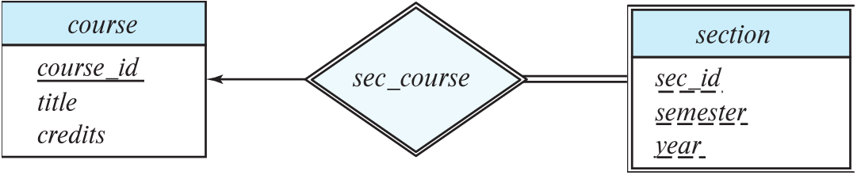
Expressing Weak Entity Sets
In E-R diagrams, a weak entity set is depicted via a double rectangle.
We underline the discriminator of a weak entity set with a dashed line.
The relationship set connecting the weak entity set to the identifying strong entity set is depicted by a double diamond.
Primary key for section – (course_id, sec_id, semester, year)

Slide 13
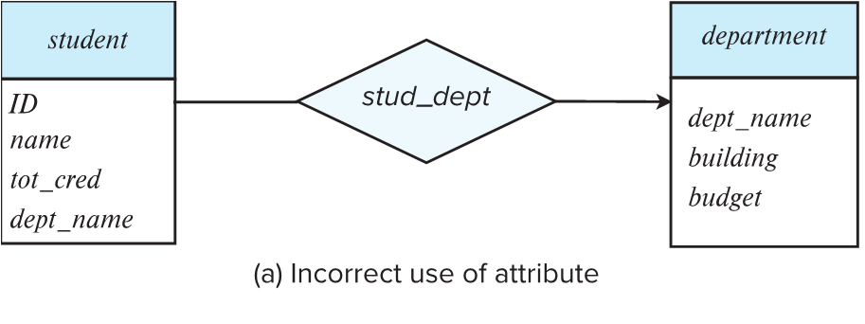
Redundant Attributes
Suppose we have entity sets:
  student, with attributes: ID, name, tot_cred, dept_name
  department, with attributes: dept_name, building, budget
We model the fact that each student has an associated department using a relationship set stud_dept
The attribute dept_name in student below replicates information present in the relationship and is therefore redundant
  and needs to be removed.
BUT: when converting back to tables, in some cases the attribute gets reintroduced, as we will see later.

Slide 14
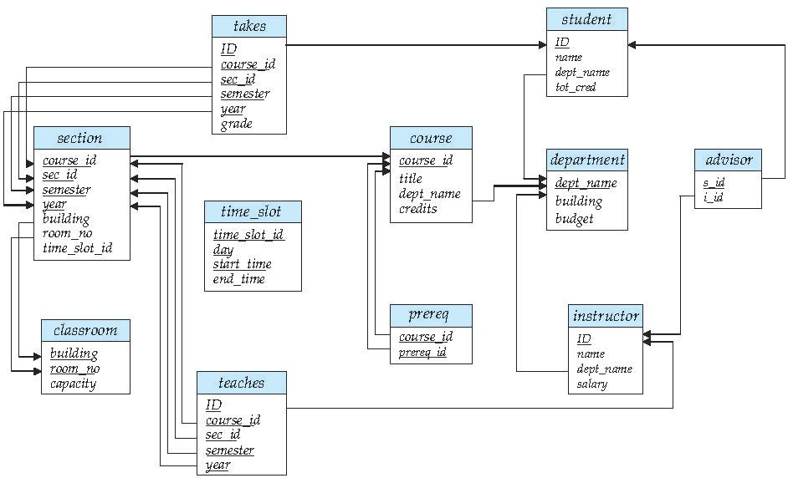
Schema Diagram for University Database (Relational Model)

Slide 15
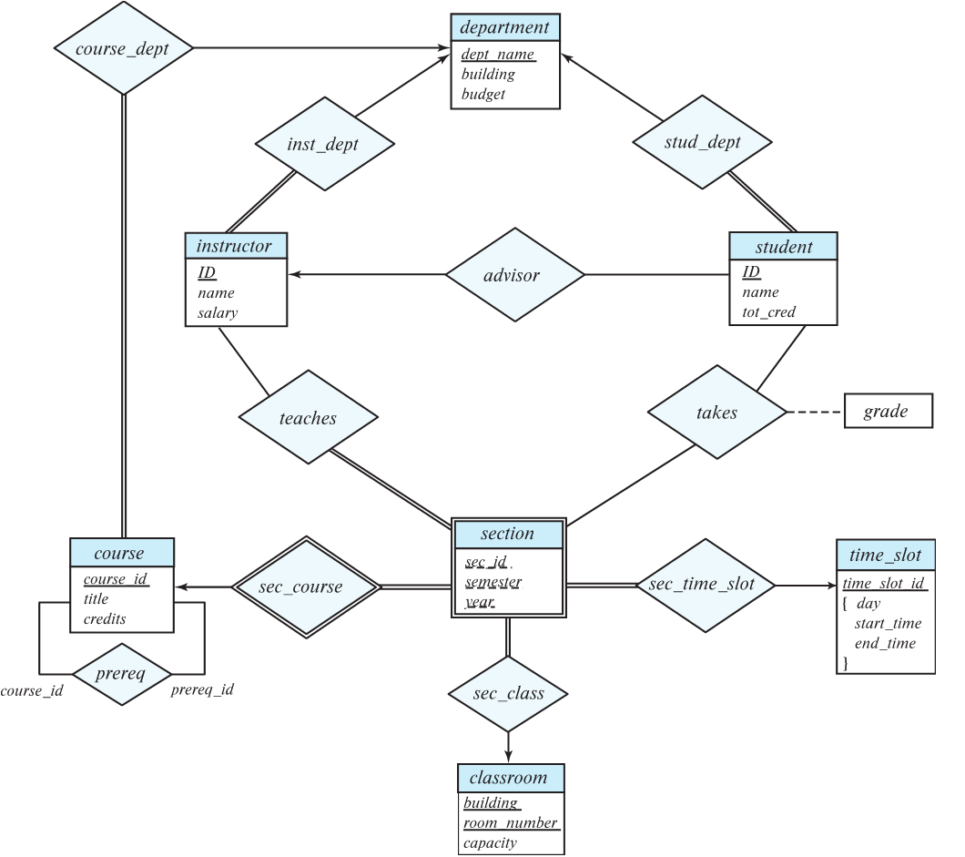
E-R Diagram for University Enterprise

Slide 16
Case Study-1
The COMPANY database keeps track of a company's employees, departments, and projects. Suppose that after the requirements collection and analysis phase, the database designers provided the following description of the "miniworld"-the part of the company to be represented in the database:
1. The company is organized into departments. Each department has a unique name, a unique number, and a particular employee who manages the department. We keep track of the start date when that employee began managing the department. A department may have several locations.
2. A department controls a number of projects, each of which has a unique name, a unique number, and a single location.
3. We store each employee's name, social security number, address, salary, sex, and birth date. An employee is assigned to one department but may work on several projects, which are not necessarily controlled by the same department. We keep track of the number of hours per week that an employee works on each project. We also keep track of the direct supervisor of each employee.
4. We want to keep track of the dependents of each employee for insurance purposes. We keep each dependent's first name, sex, birth date, and relationship to the employee.

Slide 17
Designing the ER diagram
Step-1: Identify the entity sets and attributes
1.Department – dname, dnumber, locations
2.Project – pname, pnumber, location
3.Employee – ename, SSN, address, salary, sex, birth_date
4.Dependent – fname, sex, birth_date, relationship

Slide 18
Step-2: Identify the relationships, participation constraints and cardinality ratio
1.Manages – Employee and Department with attribute start_date, 2.Controls – Department and Project
3. Works for – Employee and Department
4.Works_on – Employee and Project with attribute hours_per_week
5.Supervisor – Employee and Employee (supervised and supervise)
6.Dependent_of– Dependent and Employee

